Slide 1



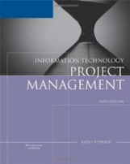
Project: MBA615 Course book Upgrade
Company: Flying Space Lime Godzillas Inc.
Presenters:
Stanley Murphy, Michael Fetick, Gabriel Ramirez, Megha Bhagat

Slide 2

Presentation Agenda
Stanley
Scope/Charter
Time
Project Integration
Michael
HR
Quality
Gabriel
Cost/Budget
Risk
Megha
Communication
Procurement/Purchasing

Slide 3
Project Charter
Project Title: MBA615 Course Textbook Upgrade
Start Date: 3 Nov 2015 Finish: 3 Mar 2016
Project Manager: Stanley Murphy
Project Objectives:
Information Technology Project Management 5th Edition
Course PPTs
Notes:
To upgrade the current MBA615 Information Technology Project Management 5th Edition course books, along with the course curriculum. Upgrades will affect the course textbooks, PowerPoint presentations and class course files.

Slide 4
Project Charter – CONT.
Approach:
Project Team
Inventory
Budget
WBS
Notes:
Choose Project Team
Inventory current books to establish new volume of updated course curriculum books
Develop budget to determine costs
Discuss and complete the Work Breakdown Structure (WBS)

Slide 5
Project Charter – CONT.
Roles and Responsibilities
Name | Role | Responsibility
LeDon Jones | CEO | Project Sponsor
Stanley Murphy | Project Manager | Monitor Project, provide staff
Megha Bhagat | Purchasing Manager | Assist in purchasing books
Michael Fetick | Human Resources Manager | Provide staff, issues memos about project
Gabriel Ramirez | Lead Librarian | Provide information about books stock and restocking
Sign-off: (Signatures of stakeholders) – LeDon Jones, Stanley Murphy, Megha Bhagat, Micheal Fetick, Gabriel Ramirez

Slide 6
Project Charter – CONT.
Comments:
1st Iteration
One Year
Adequate Resources
Notes:
1st iteration of the project, there will be follow-on work
This project MUST be completed within one year
Project should have adequate resources, however overtime will be provided if needed

Slide 7
Project Scope
Project Name: MBA615 Course Textbook Upgrade
Introduction: The purpose of this project is to upgrade the MBA615 course textbooks and curriculum for the campus classes only. The textbooks and curriculum are old and outdated and need to be revised.
Notes:
Project Name: MBA615 Course Textbook Upgrade
Introduction: The purpose of this project is to upgrade the MBA615 course textbooks and curriculum for the campus classes only. The textbooks and curriculum are old and outdated and need to be revised.

Slide 8
Project Scope – cont.
Preliminary Scope Statement:
Textbooks/Curriculum
Initial Inventory
Procurement
Secondary Inventory
Notes:
1.Textbooks/Curriculum: The textbooks for the MBA615 class will be updated to newer version of the Information Technology Project Management book.
2.An inventory of the old textbooks will be taken to understand the amount of books needed to sustain two (2) MBA615 classes simultaneously.
3.Procurement will gather purchasing/ordering/shipping information in order to understand the amount of time it will take to receive the new textbooks.
4.Once the textbooks are received, an inventory of the textbooks will take place, along with the updating of the course curriculum.

Slide 9
Time Management
Planning
Execution
Notes:
Planning: The planning portion of the project is important because the project team cannot afford to keep this course from being offered at the University. Any setbacks can affect the rollout of the new version of the class.
Execution: There is not any anticipated lapses in the execution of this project. There have been some risks identified, but the overall execution of the project should go fairly smoothly.

Slide 10
Project Integration Management
During Project Integration:
Monitor and Control
Implement change control process
Monitor scope creep
Manage time and budget
Notes:
During Project Integration:
Monitor and Control
Implement change control process
Monitor scope creep
Manage time and budget

Slide 11
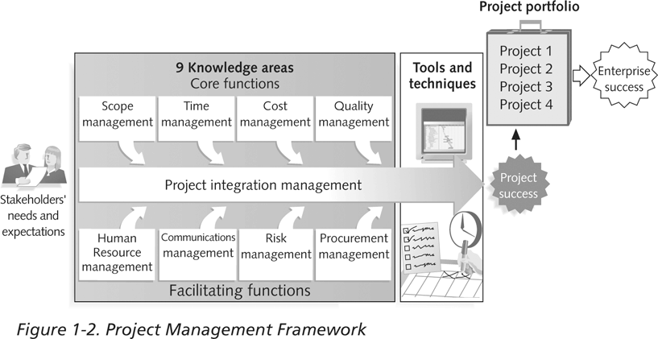
Project: MBA 615 Course book Upgrade
Project Management Framework

Slide 12
Human Resource Management
Hire two employees to help Librarian
Provide training of project tasks
Track tasks completions for milestone reporting
Requested changes
Recommended corrective and preventative actions
Organizational process assets

Slide 13
Quality Management
Outputs
Quality control measurements
Validated defect and repair deliverables
Quality baseline (updates)
Recommended corrective actions and preventative actions
Requested changes
Organizational process assets (updates)

Slide 14
Quality Management
Functional Requirements
School instructor(s) will evaluate new textbook for adoption of course subject matter
Staff will conduct inventory management and control by database entry, bar-code labeling, scanning, and shelf stocking
Students will sign receipt as temporary custodian (borrow) for each textbook

Slide 15
Quality Management
Non-Functional Requirements
Environmental qualities, such as:
Reliability – Tasks completion per requirements
Security – Physical and logical security measures
Performance – Tasks milestones on schedule
Safety –Fire Extinguishers for flammable material
Level of service – Support team access
Portability – Movement by carts
Retention – Reusability

Slide 16
Cost Management
Cost of total project (bottom-up estimates)
New books cost (MSRP, Tax, Shipping)
Hiring temps to work part time
Software for barcode
Hardware to scan barcode

Slide 17
Cost Management
Project Sponsor $ 1,730
Project Manager $ 6,768
Purchasing Manager $ 3,461
Human Resources $ 3,461
Lead Librarian $ 4,000
Barcode Scanners (2) $ 400
Cost of books $ 10,796
Shipping $ 250
Total cost of project $ 30,866

Slide 18
Risk Management
Resourcing requirements
Staff, temp hires, scheduling
Contractual disputes
Shipment issues
Delayed, Incorrect or incomplete
Project going overtime
Software issues(Barcode reader, Webclass)
Inadequate allocation of time

Slide 19
Communication Management
Regular Progress Reports
work done / estimated work to complete
deliverables delivered / projected dates for the remaining
milestones achieved / projected dates for future milestones
actual costs versus budget
earned value
projected benefit
risk analysis
issues raised / issues dealt with
new change requests

Slide 20
Communication Management
Review Meetings. Routine part of the job
performance
expectations
issues
upcoming milestone
Placing data onto a shared server
using Email
using a project management software operating through the network

Slide 21
Procurement Management
Plan Purchases: Make and buy analysis
Plan Contracting: Preparing the documents needed to do contracting. Document requirement.
Request Seller Responses: Obtaining quotations, offers
Contract Administration: Ensuring contractual requirements are met. Payment Schedules and Requests
Contract Closeout: Product verification and administration closeout
Contract re-negotiation

Slide 22
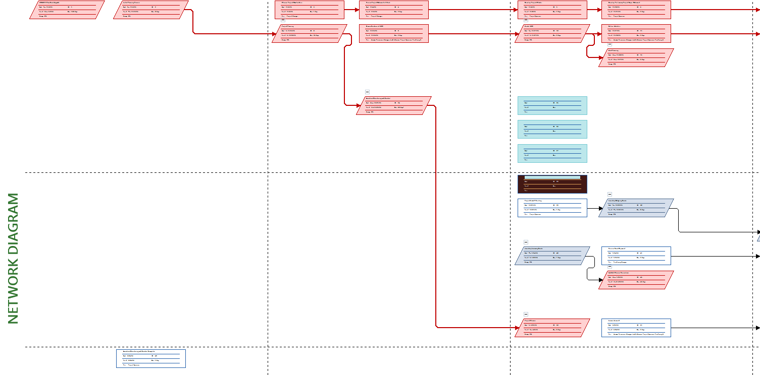
Network Diagram

Slide 23
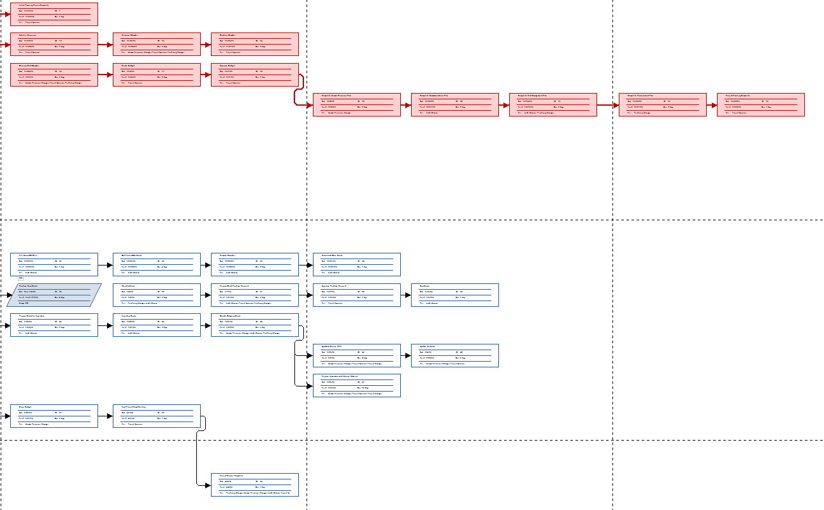
Network Diagram – CONT.

Slide 24
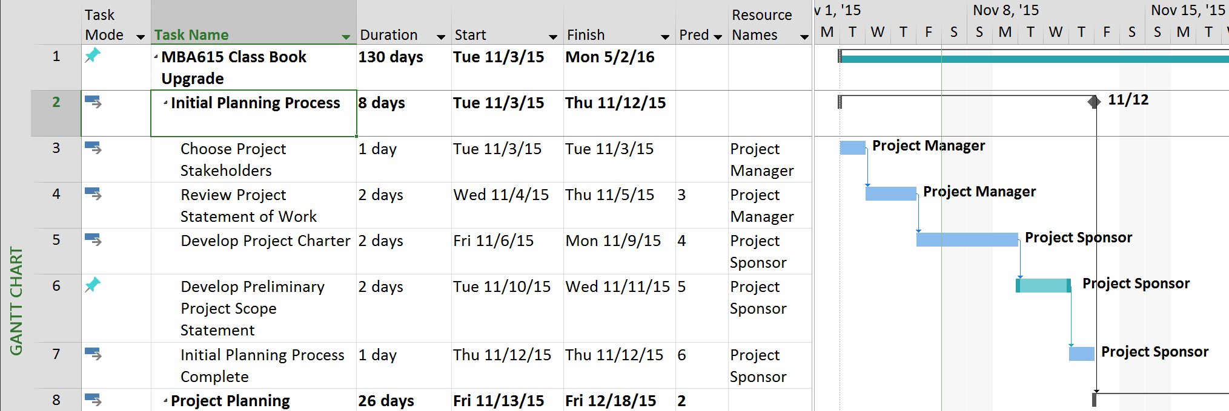
Gantt Chart

Slide 25
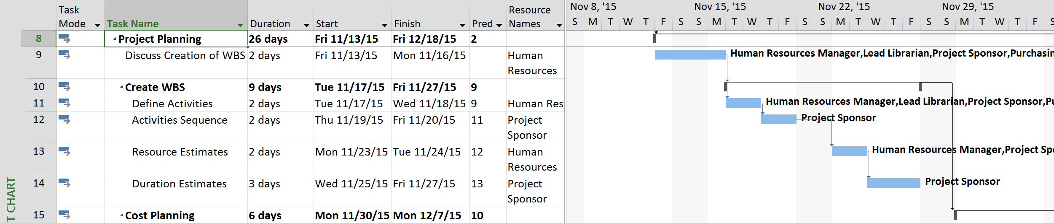
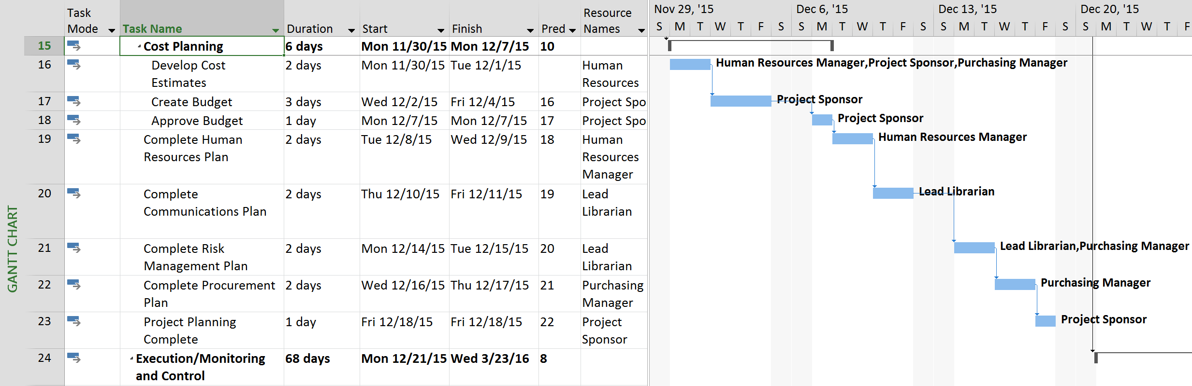
Gantt Chart – CONT.

Slide 26
Summary
Managed for Success
Completion within….
The Triple Constraint
Scope
Time
Cost
Quality
Notes:
The MBA615 Project Management textbook and course curriculum upgrade will be managed for success. The project will be completed within the triple constraint of – scope, time, and cost. The project will also be checked for quality, since the quality of the project will be judged by facility, but most importantly the students.

Slide 27
References
PMI. (2013). A Guide to the Project Management Body of Knowledge (PMBOK® Guide)—Fifth Edition. Professional Management Institute (PMI).
Schwalbe, K. (2007). Information Technology Project Management (5th ed.). Thomson Course Technology.
Coleman University OFFICIAL CATALOG. 2015-2016. Retrieved from https://www.coleman.edu/_files/pdf/Coleman-University-Catalog.pdf
Allen, I. E., & Seaman, J. (2013). Changing course: Ten years of tracking online education in the United States. Babson Park, MA: Babson Survey Research Group and Quahog Research Group. Retrieved from http://www.onlinelearningsurvey.com/reports/changingcourse.pdf
Fitzgerald, R., Anderson, M., & Thompson, R. (2015). Adding Value: Open Online Learning and the MBA. Electronic Journal of E-Learning, 13(4), 250-259. Retrieved from http://search.proquest.com/docview/1697674645?accountid=145333
Reynolds, R. (2011, June). Trends Influencing the Growth of Digital Textbooks in US Higher Education. Publishing Research Quarterly, 27(2), 178-187. doi:10.1007/s12109-011-9216-5

